Slide 1
Data Types in Python
By Dr Shantanu Pathak

Slide 2
Contents
What is data type
What is need of data type & its advantages ?
Methods of assigning data types
Data type Coercion vs type Conversion
Numeric Data types
Int, float, Boolean and complex

Slide 3
What is a Data Type?
Data type is collection of values
Each data type may have specific operations associated
Ex. Int , float can be added or subtracted
Strings are concatenated or reversed
Advantage of Data Type :
It avoids misuse / wrong use of raw data
Ex. Diving a string ‘Hello’ by 2 is meaningless

Slide 4
Need of Data type
Memory stores any data as binary
Memory doesn’t understand type of stored data
Ex. Raw data in memory :: 01000001
If data type is integer raw data is interpreted as : 65
If data type is String raw data is interpreted as : ‘A’
So, Programming language needs to keep track of the data type of data getting stored in memory. Otherwise there can be logical errors.
Python (PVM) does store all values as objects so it maintains information of the data and data type together (details in OOP)

Slide 5
When to decide data type of variable?
Methods of assigning data types
Static typing and Dynamic Typing
These method depend on the time of data type assignment
Static typing method:
When programmer creates variables that time variable is assigned a data type
Programmer needs to define variable’s data type
Here data type is assigned at Compile Time
Ex. C, C++ , JAVA , etc
Dynamic Typing method :
Data type is decided by looking at the value inside the variable
No need to assign data type to the variable
Here data type is assigned at Execution Time or Run time
Ex. Linux Script, Python, Java Script, etc

Slide 6
What happens to expression if it contains multiple data types?
Ex. Int + float 🡪 o/p will be int or float ?
CPU -> separate hardware for int operations, float operations
So CPU can’t have operations on mix types
Solution : convert one of the value and get both values in same data type
Two ways of conversion :
Coercion
Type conversion

Slide 7
Data type Coercion vs type Conversion
1. Coercion : convert the data type implicitly / internally
Int + float --> int is automatically converted to float
Int + bool --> bool is automatically converted to int
Same conversion for all arithmetic operators
For all logical operators Truth Value is used to convert object to True or False
2. Type Conversion : programmer explicitly converts data type
type() : this is function to check the data type of the value / object
Ex. type(1) -> int
type(3.14) -> float
type(‘ABC’) -> str
isinstance(x, type) : this is function to verify if given object is of a particular type
Ex. isinstance(1,int) -> True

Slide 8
type Conversion functions
Following functions (constructors) are used for type conversion
float() : convert to int, string to float
str(): convert object to string using __str__() or repr() methods. Also can convert bytes to string using given encoding
bool() : give truth value of the object. Returns True or False
complex() : convert string, float, int to complex
int() : convert given float, string to int. Also converts binary / octal / hex strings to int using base parameter (details discussed ahead)
bin() : convert int to binary string
oct() : convert int to octal string
hex() : convert int to hex string
chr() : convert int (ASCII) to single character string
ord() : convert character to ascii

Slide 9
Data Types in Python

Slide 10
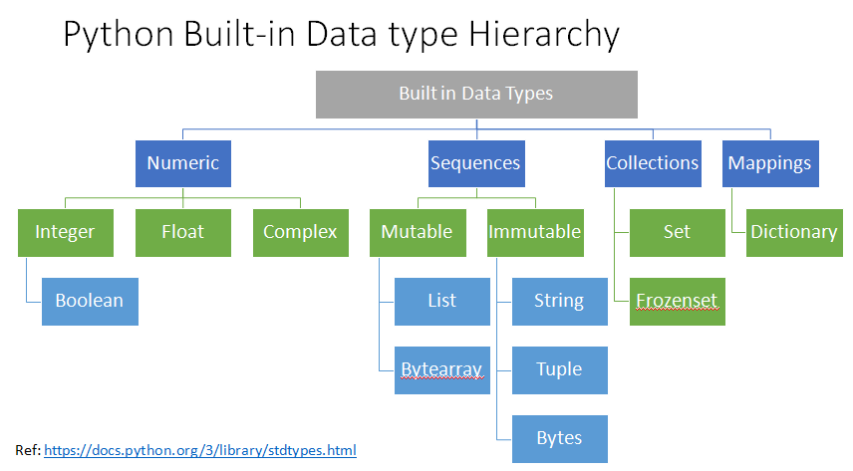

Slide 11
Python Built-in Data types
Data type | Mutable / Immutable | Size | Order | Hierarchy
int | Immutable | Dynamic | - | Numeric
float | Immutable | Fix | - | Numeric
complex | Immutable | Fix | - | Numeric
bool | Immutable | Fix | - | Numeric
str (string) | Immutable | Fix | Ordered | Sequence
tuple | Immutable (*Special case) | Fix | Ordered | Sequence
list | Mutable | Dynamic | Ordered | Sequence
set | Mutable | Dynamic | Un-ordered | Collections
dict | Mutable | Dynamic | Ordered | Mappings
bytes | Immutable | Fix | Ordered | Sequence
bytearray | Mutable | Dynamic | Ordered | Sequence
frozenset | Immutable | Fix | Un-ordered | Collections

Slide 12
Concept of Immutable Data Types
Once object is created then can’t change the contents
If variable value is changed
Then new object is created
Ex.
i = 230 # create object with value 230 and assign it to i
id(i) # get the identity of an object (ex. 17889)
# ( indicates where it is in memory)
i = 10 # create new object with value 10
#(at different location in memory)
#and assign it to i
id(i) # get the identity of an object (ex. 17867)
Mutable Data types : we can change the contents any time

Slide 13
Concept of memory allocation to data types
Fix Size : Size of object is fixed at time of creation itself (compile time)
Dynamic : Size of object can change anytime ( run time)
Size of object can be found by sys.getsizeof() function
Different data types have different sizes of memory

Slide 14
Interning Smart Memory Allocation
Interning in int (smart allocation)
When new variable is created with literal (fixed value)
Step 1: check if value is small
If small (-5 to 256) then check if already value “object” is present
If object is present then DON’T allocate new memory, use same object
Step 2: If Value is not small then allocate new memory and create new object
When new variable with dynamic value
Always allocate memory and create new object
Ref: https://python-reference.readthedocs.io/en/latest/docs/functions/intern.html

Slide 15
Interning Smart Memory Allocation(cont..)
Interning in string
2 ways smart allocation takes place
1. Cache the ASCII characters ( Latin 1 range)
Python 3.3+ first 128 ASCII characters are cached by PVM
So, a string containing all ASCII characters will be references to these cached characters
Other Unicode characters can have size 1 -4 bytes
https://docs.python.org/3/c-api/unicode.html

Slide 16
Interning Smart Memory Allocation(cont..)
Interning in string
2. Use sys.intern() function
Programmer can decide to store strings in memory using sys.intern() function
Here string is stored in a table and if same string is used again then reference to stored string is given to the new object. So, no new memory is required for using same string multiple times in a program.
Normally, the names used in Python programs are automatically interned, and the dictionaries used to hold module, class or instance attributes have interned keys.
Ref: https://docs.python.org/3/library/sys.html

Slide 17
Built in Data Types in Python
Numeric Data types :
int
float
complex
bool ( sub type of int data type)

Slide 18
Common methods to all Numeric data Type
abs(x) : give absolute value of x
divmod(x,y) : returns pair ( x //y , x % y)
x.conjugate() : gives conjugate of complex number x
pow(x,y) : same as x ** y , x raised to y
round(x, n) : round value of x to n digits, by default n=0
bool(x) : gives truth value of given object x. Returns True or False

Slide 19
int data type
Python supports scientific computing so maximum value of int is not fixed ( it is unlimited)
so size of integer allowed is unlimited
Integer is stored in a special structure in python
In Python, value of an integer is not restricted by the number of bits and can expand to the limit of the available memory
First 24 bytes are allocated for basic structure of Python for integer creation
Then 4 byte from value 1 & ahead till 2^30-1
After that 4 bytes are added whenever value exceeds the limit (next 2^30 values)
This goes on till the time memory ( heap) is available
Sign of an integer is stored in sign bit
Size of object can be found by sys.getsizeof() function

Slide 20
How Negative Integers are handled in Python?
Python represents negative numbers as signed magnitude format
Problem :
Cannot have right representation of -0 and +0
Cannot perform arithmetic operations properly
Solution
Zero is handled as special case
Before any operation convert -ve number to 2’s complement

Slide 21
int data Type methods
int.bit_length(x) : Returns the number of bits necessary to represent an integer in binary, excluding the sign bit and leading zeros
int.as_integer_ratio() : Return a pair of integers whose ratio is exactly equal to the original integer and with a positive denominator. The integer ratio of integers (whole numbers) is always the integer as the numerator and 1 as the denominator.
Ex. (6).as_integer_ratio() -> (6,1)

Slide 22
Float data type
Float stores decimal point values
It is same as double point precision in C
Float is fixed size (24 bytes) in python
Range of Values in float :
10^-308 to 10^+308 with 16 to 17 digits of precision
Beyond this limit there is arithmetic overflow (inf) or arithmetic underflow (0.0) values assigned
Ex.
1e400 -> inf (Overflow)
1e-400 -> 0 (underflow)

Slide 23
float data Type methods
float.as_integer_ratio() : For float x, Return a pair of integers whose ratio is exactly equal to the original integer and with a positive denominator. The integer ratio of integers (whole numbers) is always the integer as the numerator and 1 as the denominator.
Ex. (10.5).as_integer_ratio() -> (21,2)
numerator , denominator = (1.35).as_integer_ratio()
float.is_integer() : Return True if x is int value, and False otherwise
float.hex() : Return a representation of a floating-point number ‘x’ as a hexadecimal string. For finite floating-point numbers, this representation will always include a leading ‘0x’ and a trailing ‘p’ and exponent.
float.fromhex(x) : Class method to return the float represented by a hexadecimal string x. The string s may have leading and trailing whitespace.
A hexadecimal string takes the form:
[sign] ['0x'] integer ['.' fraction] ['p' exponent]
Note that the exponent is written in decimal rather than hexadecimal, and that it gives the power of 2 by which to multiply the coefficient
For example, the hexadecimal string 0x3.a7p10 represents the floating-point number (3 + 10.0/16 + 7.0/16**2) * 2.0**10

Slide 24
Complex Data Type
complex() : constructor to create complex number
Takes real and imaginary part as input
Return complex number inform (real + img j)
Ex. complex(3,4) -> 3+4j
complex(0) -> 0j
complex.conjugate() : return conjugate complex number
Conjugate of a complex number is complex number with same real and imaginary part ONLY Sign is changed
Ex. (1+2j).conjugate() -> 1-2j
(4 -102j).conjugate() -> 4+102j

Slide 25
Bool (Boolean) Data Type
bool() -> returns truth value
Truth value testing Rules:
Any object can be tested for truth value, for use in an if or while condition or as operand of the Boolean operations.
By Default True values :
an object is considered true unless its class defines either a __bool__() method that returns False or a __len__() method that returns zero, when called with the object.
By Default False values :
constants defined to be false: None and False.
zero of any numeric type: 0, 0.0, 0j, Decimal(0), Fraction(0, 1)
empty sequences and collections: '', (), [], {}, set(), range(0)

Slide 26
Extra

Slide 27
Extra
In Python Dynamic typing of variables is called as Duck typing
Duck typing means anything which sounds like a duck is a duck!
Any variable having int value will be given int data type
Any variable having float value will be given float data type
int.bit_count(): In python 3.10+ Return the number of ones in the binary representation of the absolute value of the integer. This is also known as the population count
int.to_bytes(length,byteorder) : For int x Return an array of bytes representing an integer. Byteorder can be ‘big’ endian or ‘small’ endian.
Ex. (1024).to_bytes(2,'big') -> b'\x04\x00'
int.from_bytes(bytes, byteorder='big', *, signed=False) : Return the integer represented by the given array of bytes.
int(002) -> leading zeros are not allowed while creating an int object

Slide 28
Extra
NOTE: While using float.hex() and float.fromhex(x) when we convert hex to decimal and then decimal back to hex. That time system may give different hex representation of the same decimal value
Ex. float.fromhex('0x3.a7p10') 🡪 3740.0
Applying the reverse conversion to 3740.0 gives a different hexadecimal string representing the same number:
(3740.0).hex()
'0x1.d380000000000p+11‘
Read About Hashing of numeric types
Integer memory allocation in python
https://www.laurentluce.com/posts/python-integer-objects-implementation/
First 24 byte of int details : https://betterprogramming.pub/what-is-up-with-the-numbers-in-python-26d8d36e129b
Working of bitwise NOT on int https://stackoverflow.com/questions/72241864/understanding-bitwise-not-in-python

